Slide 1
Seminar Presentation on the topic “Spam Detection using Naïve Bayes Classifier”
Pratikshya Chaudhary
Roll no. = 07

Slide 2
CONTENT
Introduction
Objective
Literature Review
Methodology
Implementation
Result and Analysis
Conclusion
References

Slide 3
INTRODUCTION
E-Mail is a powerful online communication mode because it saves money and helps reduce communication time.
Spam is an unwanted, junk, unsolicited bulk mails used to spreading virus, Trojans, malicious code, advertisement or to gain profit on negligible cost.
Ham is legitimate, wanted, solicited mails.
Emails
Spam
Ham

Slide 4
INTRODUCTION contd..
Email spamming is increasing day by day because of effective, fast and cheap way of exchanging information with each other. User receives
About billions of spam mails are sent per day and the cost of sending is approximately zero.
Spam is major problem that attacks the existence of e-mails. So, it is very important to distinguish ham emails from spam emails, many methods have been proposed for classification of email as spam or ham emails.
spam mails
>
ham mails

Slide 5
OBJECTIVE
To classify the email into spam and non-spam.
To evaluate the performance of Naïve Bayes algorithm for e-mail spam filtering on the chosen datasets.

Slide 6
LITERATURE RIVIEW
Blanzieri and Bryl describe a list of learning-based email spam filtering approaches. In this paper, they addressed the spam problems and provided a review of learning-based spam filtering. They explain various features of spam emails.
Saleh et al. present a survey on intelligent spam email detection. They discuss various security risks of email, especially spam emails, the scope of spam analysis, and different machine learning and nonmachine learning techniques for spam detection and filtering.
Bhuiyan et al. present a review of current email spam filtering approaches. They summarize multiple spam filtering approaches and sum up the accuracy on various parameters of different proposed systems by analyzing numerous processes.

Slide 7
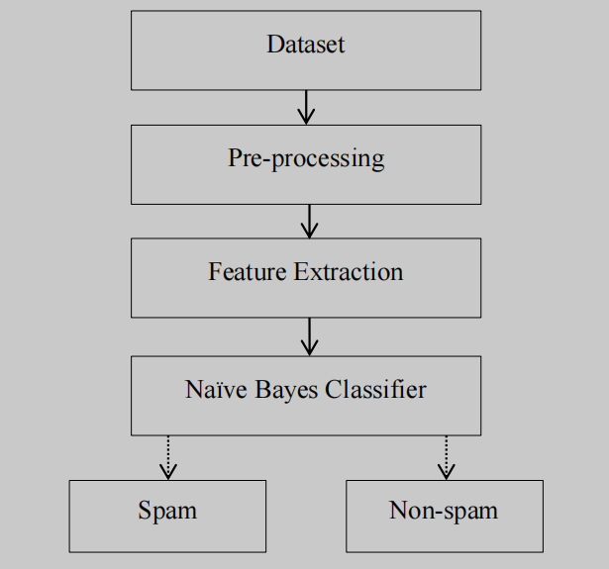
METHODOLOGY

Slide 8
METHODOLOGY contd...
We have taken the collection of mail messages for dataset. It is free and can be downloaded from the Kaggle.
Pre-processing of e-mails in next step of training filter, some words like conjunction words, articles are removed from email body because those words are not useful in classification.
We use TfidfVectorizer model from sklearn library that can quantify the importance or relevance of string representations (words, phrases, lemmas, etc) in a document amongst a collection of documents.
Naïve Bayes technique used Bayes theorem to determine that probabilities spam e-mail.

Slide 9

Naïve Bayes Classifier
P(A|B) is a conditional probability; the likelihood of event A occurring given that B is true.
P(B|A) is also a conditional probability; the likelihood of event B occurring given that A is true.
P(A) and P(B) are the probabilities of observing A and B independently of each other.

Slide 10
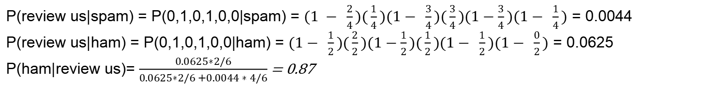
How Naïve Bayes Classifier works for Spam detection?
Example:
Separate spam from valid email, attributes = words
D1: “send us your password”
D2: “send us your review”
D3: “review password”
D4: “review us”
D5: “send your password”
D6: “send us your account”
spam
ham
ham
spam
spam
spam
P(spam) = 4/6 P(ham) = 2/6
spam | ham
2/4 | 1/2 | password
1/4 | 2/2 | review
3/4 | 1/2 | send
3/4 | 1/2 | us
3/4 | 1/2 | your
1/4 | 0/2 | account
new email : “review us now”
P(review us|spam) = P(0,1,0,1,0,0|spam) = $(1 − \frac{2}{4})(\frac{1}{4})(1− \frac{3}{4})(\frac{3}{4})(1−\frac{3}{4})(1− \frac{1}{4})$ = 0.0044
P(review us|ham) = P(0,1,0,1,0,0|ham) = $(1− \frac{1}{2})(\frac{2}{2})(1−\frac{1}{2})(\frac{1}{2})(1− \frac{1}{2})(1− \frac{0}{2})$ = 0.0625
P(ham|review us)= $\frac{0.0625∗2/6}{0.0625∗2/6 +0.0044 ∗ 4/6}$ = 0.87

Slide 11
IMPLEMENTATION
Hardware Required
Windows 7 or 10
Mac OS X 10.11 or higher, 64-bit
Linux: RHEL 6/7, 64-bit (almost all libraries also work in Ubuntu)
x86 64-bit CPU (Intel / AMD architecture)
4 GB RAM
Software Required
Python 3
Numpy 1.17.3
Matplotlib 3.1.2
Panda 1.0.5
sklearn

Slide 12
RESULT AND ANALYSIS
Accuracy | Precision | Recall | F1 Score
98.20507067534216 % | 97.97108800405783 % | 100.0 % | 98.97514732257238 %
Table1: Taining data analysis

Slide 13
RESULT AND ANALYSIS contd..
Accuracy | Precision | Recall | F1 score
98.20507067534216 % | 93.9453125 % | 100.0 % | 96.87814702920443 %
Table2: Test data analysis

Slide 14
CONCLUSION
Naïve Bayes classifier that used has a very important role in this process of filtering e-mail spam.
The quality of performance Naïve Bayes classifier is also based on datasets that used. As can see, dataset that have fewer instances of e-mails and attributes can give good performance for Naïve Bayes classifier.
Naïve Bayes classifier also can get highest precision that give highest percentage spam message manage to block if the dataset collect from single e-mail accounts.

Slide 15
REFERENCES
I. Androutsopoulos, G Paliouras, and Michelakis, "E. Learning to filter unsolicited commercial e-mail," Technical report NCSR Demokritos 2011.
E. Blanzieri and A. Bryl, "A survey of learning-based techniques of email spam filtering," Artificial Intelligence Review, vol. 29, pp. 63-92, 2008.
E. Blanzieri and A. Bryl, "E-mail Spam Filtering with Local SVM Classifiers," University of Trento, Trento, Italy, 2008.
A. Karim, B. Shanmugam et al. A. J. Saleh, "An intelligent spam detection model based on artificial immune system," vol. 10, pp. 6-209, 2019.
I. Zaharakis, and P. Pintelas S. B. Kotsiantis, "Supervised machine learning: a review of classification techniques," Emerging artificial intelligence applications in computer engineering, vol. 160, pp. 3-24, 2007.
A. Ashiquzzaman, T. Islam Juthi, S. Biswas, and J. Ara H. Bhuiyan, "A survey of existing e-mail spam filtering methods considering machine learning techniques," Global Journal of Computer Science and Technology, vol. 18, 2018.
A. Asuncion and D. Newman. (2007) UCI machine learning repository. [Online]. https://archive.ics.uci.edu/ml/index.php
T. and Sherekar, S. Patil, "Performance Analysis of NaIve Bayes and Classification Algorithm for Data Classification," International Journal Of Computer Science And Applications, 2013.

Slide 16
Thank you !!

